Slide 1
Module 1 - Introduction to the Theory of Computation
COT 4420 Theory of Computation

Slide 2
Module 1 - Introduction to the Theory of Computation
Module 1.1 Mathematical Preliminaries and Notation
Sets
Functions and relations
Graphs
Proofs
Module 1.2 Three Basic Concepts
Languages
Grammars
Automaton

Slide 3
Module 1 - Introduction to the Theory of Computation
Introduction
Hierarchy of languages and automata

Slide 4
Module 1 – Introduction to the Theory of Computation
1930s before there were computers, Alan Turing studied an abstract machine that had all the capabilities of today’s computers(as far as what they could compute)
Turing’s goal was to describe precisely the boundary between what a computing machine could and could not do
His conclusions apply not only to abstract Turing Machines, but to today’s real machines

Slide 5
Module 1 – Introduction to the Theory of Computation
Theoretical computer science includes the study of language definition, pattern recognition, the capabilities and limitations of algorithmic computation, and the analysis of the complexity f problems and their solutions.
Theory provides concepts and principles that help us understand the general nature of computer science
To study basic principles, we construct abstract models of computers and computation

Slide 6
Module 1 – Introduction to the Theory of Computation
Automata theory
Formal languages
Grammars
Automata, grammars, and computability are the study of what can be done by computers in principle
Complexity addresses what can be done by computers in practice

Slide 7
Module 1 – Introduction to the Theory of Computation
Automata (plural for automaton) – model the hardware of a computer
accepts input
produces output
may have temporary storage
can make decisions in transforming the input to output
often classified by the class of language they accept
Formal Language- An abstraction of the general characteristics of a programming language
Grammars - used to generate languages
Automata Theory – mathematical models of computation, the study of abstract computing devices

Slide 8
Module 1 - Introduction to the theory of Computation Hierarchy of languages and automata
Language Automaton Grammar Production Rules
Recursively enumerable Turing Machine no restrictions
LHS (V ∪ T )⁺ → RHS (V ∪ T )*
Context sensitive Linear Bounded Automata LHS (V ∪ T )⁺ → RHS (V ∪ T )⁺
LBA x → y , |x| ≤ |y|
Context free nondeterministic single V → RHS (V ∪ T )⁺
push down automata (NPDA)
Regular DFA/ NFA right linear/ left linear

Slide 9
Module 1.1 Mathematical Preliminaries and Notation
Sets
Functions and relations
Graphs
Proofs

Slide 10
Module 1.1 Sets
Set is a Collection of elements, without any structure other than membership.
S = {0,1,2} //set of integers 0, 1, 2
Set S, x element in S notation: x ∈ S
Set S, x element NOT in S notation: x ∉ S
S= {i: i > 0, i is even}
//S is the set of all i such that i is greater than 0 and i is even

Slide 11

Module 1.1 Sets
Union ∪ S1 ∪ S2 = {x: x ∈ S1 or x ∈ S2 }
Intersection ∩ S1 ∩ S2 = {x: x ∈ S1 and x ∈ S2 }
Difference - S1 - S2 = {x: x ∈ S1 and x ∉ S2 }
U universal set
S compliment is $\overline{S}$ = {x: x ∈ U and x ∉ S }
empty set/null set
S ∪ ∅ = S - ∅ = S
The compliment of ∅ is U (universal set)
$\overline{\overline{S}}$ = S

Slide 12
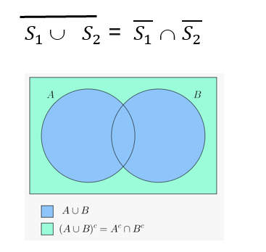
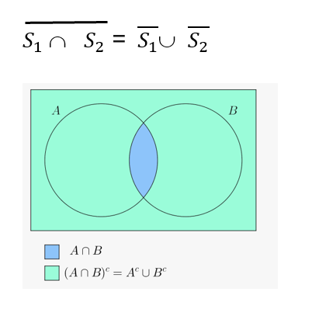
Module 1.1
DeMorgans Law:

Slide 13

Module 1.1 Sets
Subset: $S_{1}$ ⊆ S
Proper Subset: $S_{1}$ ⊂ S //S contains an element not in $S_{1}$
Disjoint: $S_{1}$ ∩ $S_{2}$ = ∅
|S| - number of elements in S
Powerset: The set of all subsets of S is denoted by $2^{s}$
Powerset example:
S= {a,b,c}
$2^{s}$ = {∅, {a}, {b}, {c},{a,b},{a,c},{b,c},{a,b,c}}
|$2^{s}|=2^{|s|}$

Slide 14
Module 1.1 Sets
Cartesian (Cross Product) – set operation that builds a set consisting of
ordered pairs of elements from 2 existing sets -
Sets: A and B
A x B = {(x, y) | x ∈ A and y ∈ B}
Example: A = {1,2,3}, B={1,2}
A x B = {(1,1), (1,2), (2,1), (2,2), (3,1), (3,2)}

Slide 15
Module 1.1 functions and relations
Functions
each element of the domain has exactly one associated element in the range
F : A → B
{y ∈ B | y = f(x) for some x ∈ A}
If functions are represented as ordered pairs, if x1 is an element in the domain and y1 is an element in the range, x1 can occur at most once, otherwise it is a relation.

Slide 16
Module 1.1 graphs and trees
Graph – construct consisting of 2 finite sets
Vertices V = {v1, v2, v2, …vn}
Edges E = {e1, e2, e2, …em}
Each edge is a pair of vertices: Ei = (vj, vk) - pair 2 tuple
A sequence of edges is said to be a walk
Tree - A directed graph such that there is exactly one path from the root to every other vertex

Slide 17
Module 1.1 Proofs
Proof – set of logical arguments that the statement is true
Theorem – a statement that is made/ has been proven to be true
Corollary – statements easily concluded by a theorem
Lemma - a minor result that has been proved to be true and used as a steppingstone to a larger result

Slide 18
Module 1.1 Proofs
Recursive definition
Define elements in a set in terms of other elements in a set
Mathematical Induction
A technique by which the truth of a number of statements can be inferred from the truth of a few specific instances,
Proof by Contradiction
Want to prove P is true
Assume P is NOT true
Come to conclusion that is clearly absurd
Proof by Counter Example
exception to a proposed general rule
Proof by Construction
proof by example

Slide 19
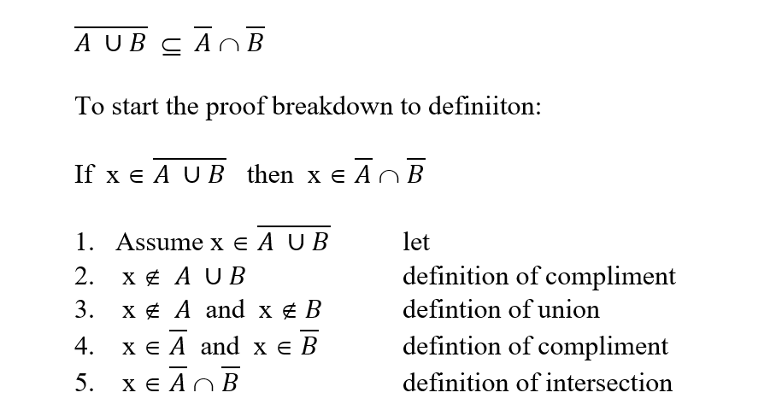
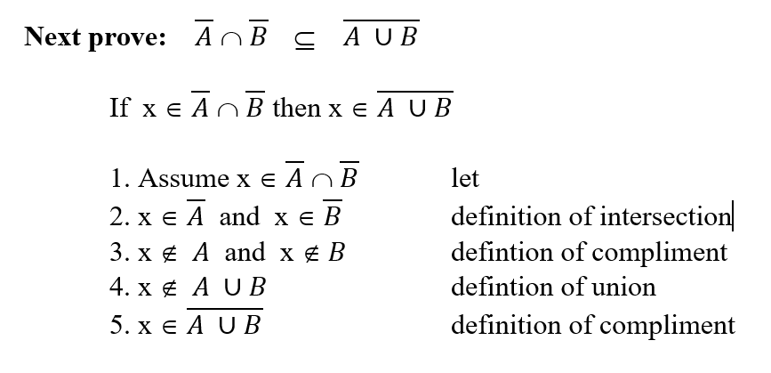
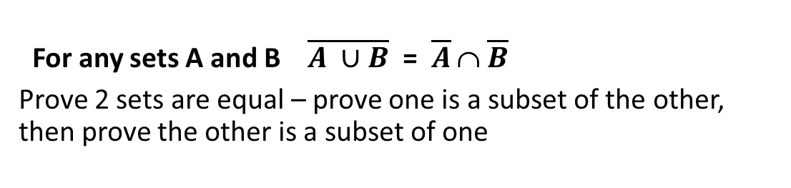
Module 1.1 Proof example
For any sets A and B $\overline{A ∪B}$ = $\overline{A}$ ∩ $\overline{B}$
Prove 2 sets are equal – prove one is a subset of the other, then prove the other is a subset of one

Slide 20
proof by construction
For all n such that n is even and n > 2 there exists a 3 regular graph

Slide 21
proof by construction
For all n such that n is even and n > 2 there exists a 3 regular graph
Arrange n nodes in a circle

Slide 22
proof by construction
For all n such that n is even and n > 2 there exists a 3 regular graph
Arrange n nodes in a circle
Connect the circle

Slide 23
proof by construction
For all n such that n is even and n > 2 there exists a 3 regular graph
Arrange n nodes in a circle
Connect the circle
Connect each node to the opposite node in the circle

Slide 24
Module 1.2 Three Basic Concepts
Languages
Grammars
Automaton

Slide 25
Module 1.2 Languages
Alphabet: Finite, nonempty set Σ of symbols: Σ = {a,b} //alphabet
Strings – constructed from the alphabet: aaabbba
string named w: w = abaaa
concatenation of 2 strings: w = abab
v = aaa
wv – ababaaa
The reverse of a string: w = abab
wR – baba

Slide 26

Module 1.2 Languages
The length of a string: | w|
λ -- The empty string
|λ| = 0
$w^{n}$ stands for a string of length n
${ w}^{0}$ = λ
Σ is the alphabet
$^{∗}$ is a language (every possible string that can be made)
$^{+}$ = $^{∗}−$λ

Slide 27

Module 1.2 Languages
A sentence is a string in a language
Example:
Let Σ = {a,b, then $^{∗}$= {λ, a, b, aa, ab, ba, bb, aaa, aab, . . . }
The set {a, aa, aab} is a language on Σ
L = {$a^{n }b^{n }$: n ≥ 0}

Slide 28

Module 1.2 Languages
The compliment of Language is defined in terms of $^{∗}$
The reverse of a Language is the set of all string reversals

Slide 29
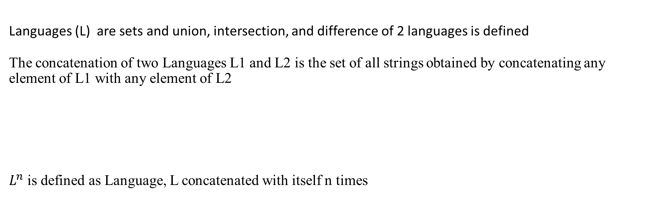
Module 1.2 Languages
Languages (L) are sets and union, intersection, and difference of 2 languages is defined
The concatenation of two Languages L1 and L2 is the set of all strings obtained by concatenating any element of L1 with any element of L2
$L^{n}$ is defined as Language, L concatenated with itself n times

Slide 30
Module 1.2 Languages
star- closure of a Language, L is defined as
Positive closure of Language L is defined as

Slide 31
Module 1.2 Grammars
Grammars are used to generate languages
G = (V, T, S, P) quadruple
V – Finite set of objects called variables (usually upper case letters)
T – Finite set of objects called terminal symbols (usually lower case letters, the alphabet, Σ)
S – Start Symbol (S ∈ V)
P – Set of productions – production rules specify how the grammar transforms one string to another
sets V and T are non empty and disjoint
LHS(Left hand side) string → RHS(Right hand side) string
LHS(Left hand side) (V ∪ T )⁺ there must be a symbol on the left hand side
RHS(Right hand side) (V ∪ T )* the empty string may be on the right side

Slide 32

Module 1.2 Grammars
Grammars have production rules that specify how the grammar transforms one string into another
G = (V, T, S, P)
G = ({S}, {a,b}, S, P)
The production rules (P ) are:
S → aSb
S → λ
L(G) = {$a^{n }b^{n }$: n ≥ 0}

Slide 33

Module 1.2 Grammars
L(G) = {$a^{n }b^{n+1 }$: n ≥ 0}
G = ({S,A}, {a,b}, S, P)
The production rules (P ) are:
S → Ab
A→ aAb
A → λ

Slide 34

Module 1.2 Grammars
= {$a,b\}$
G = ({S,A}, {a,b}, S, P)
The production rules (P ) are:
S → Ab
A→ aAb
A → λ

Slide 35
Module 1.2 Automaton
Automata
An automaton is an abstract model of digital computer.
Input – string over a given alphabet
Can read but not modify
Reads input from left to right, one symbol at a time
An automaton whose output is a simple yes or no is called an acceptor
An automaton capable of producing strings of symbols as output is called a transducer
DFA - Deterministic Finite Automata/Acceptor (DFA)
NFA - Nondeterministic Finite Automata/Acceptor (NFA)

Slide 36
Module 1 - Introduction to the theory of Computation Hierarchy of languages and automata
Language Automaton Grammar Production Rules
Recursively enumerable Turing Machine no restrictions
LHS (V ∪ T )⁺ → RHS (V ∪ T )*
Context sensitive Linear Bounded Automata LHS (V ∪ T )⁺ → RHS (V ∪ T )⁺
LBA x → y , |x| ≤ |y|
Context free nondeterministic single V → RHS (V ∪ T )⁺
push down automata (NPDA)
Regular DFA/ NFA right linear/ left linear

